Slide 1

TOP 5 ANIMES 2022

Slide 2


Slide 3

1# - Classroom of the Elite

Slide 4


Slide 5

2# - Arifureta Shokugyou de Sekai Saikyou Second Season

Slide 6


Slide 7
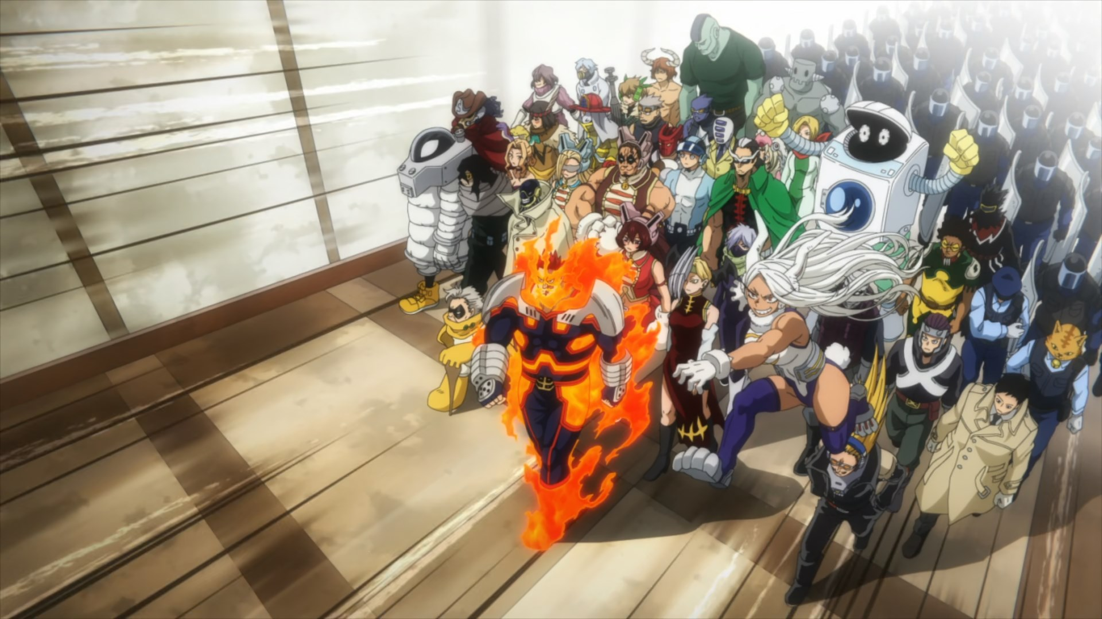
3# - Boku no Hero S6

Slide 8
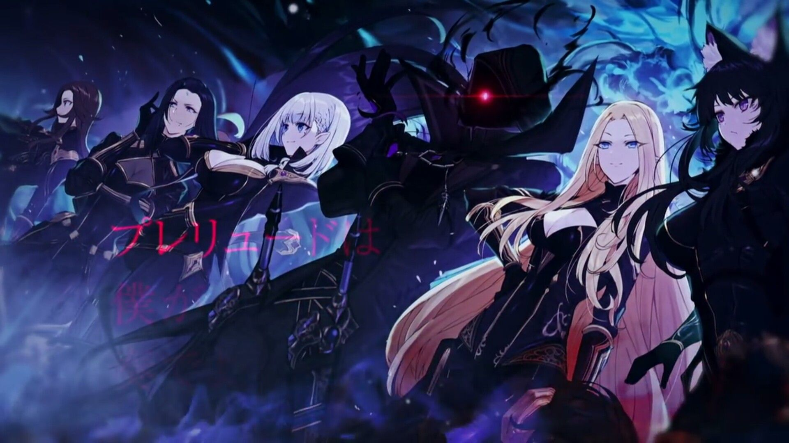

Slide 9

4# - Kage no Jitsuryokusha ni Naritakute!

Slide 10


Slide 11

5# - Ojisan Another World

